Slide 1
Challenges and Opportunities of International Cooperation
A global perspective on diplomacy, security, and economic interdependence
By: Professor Mehri Madarshahi
CEIBS. Shanghai, China

Slide 2
Historical Context 🕰️
📜 Post-WWII global institutions (UN, IMF, NATO, EU, etc.)
⚖️ Evolution of global power dynamics

Slide 3
Timeline showing key global events influencing international relations-Historical Context
WWII global institutions: The UN, IMF, NATO, and EU
China’s Rise & Global Influence: China's WTO entry in 2001, the Belt and Road Initiative in 2013, and the AIIB in 2015
Impact of COVID-19: Worsened US-China relations and led to declining trust in multilateral organizations

Slide 4
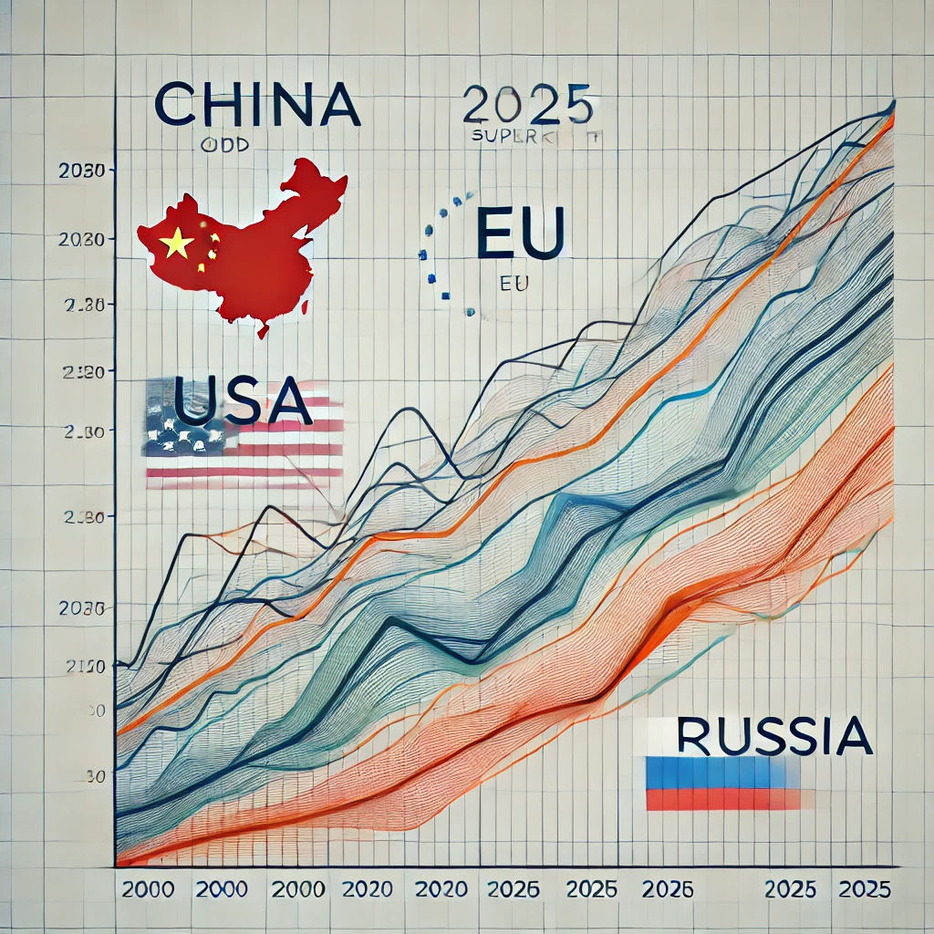
China’s Rise & Global Influence 🇨🇳
WTO entry (2001),
Belt and Road Initiative (2013),
AIIB (2015)🚀
China’s technological and economic expansion

Slide 5
Impact of COVID-19 🦠
🌍 US-China relations worsened
🏛️ Declining trust in multilateral organizations

Slide 6
Challenges to Global Governance
- US-China power struggle
Rise of protectionism & economic nationalism
- NATO expansion, Indo-Pacific strategies
- Declining influence of and funding for UN, WTO, WHO

Slide 7
Ukraine War & Its Global Impact
- Economic sanctions and geopolitical shifts
- Strengthening Russia-China-Iran ties

Slide 8
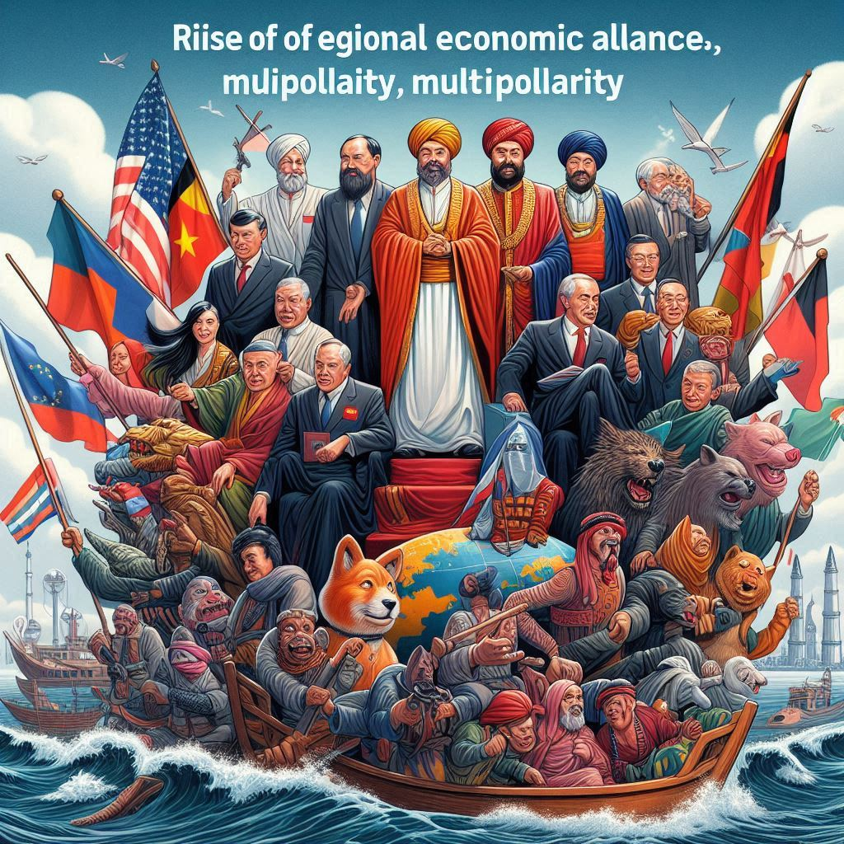
Shift to Multipolarity
BRICS expansion and non-dollar trade
- Rise of regional economic alliances
Russia, solidified its alliances with China, Iran, and North Korea
China deepened its ties with Russia, Iran, and North Korea and coordinated its efforts in areas such as military cooperation

Slide 9
African and Latin American countries –Economic distress
China’s engagement with Africa
increase investments on the continent

Slide 10
Situation in the Middle East-Rising instability
Gaza, Iran, Lebanon, Syria, Iran war with Israel

Slide 11
AI, Quantum Computing, & Space Rivalries
Technological competition shaping diplomacy
- Digital sovereignty concerns

Slide 12
Climate Change Cooperation & Setbacks
Kunming-Montreal Global Biodiversity Framework
- US withdrawal from climate agreements

Slide 13
The Path Forward
Need for strong multilateral institutions
- Diplomacy and arms control as solutions

Slide 14
Conclusion
**Key Message:**
- Cooperation over conflict for a more stable future

