Slide 1
SHAPING THE FUTURE EMBRACING DIGITAL TRANSFORMATION FOR ETHICAL GOVERNANCE MOVEMENTS
Professor Mehri Madarshahi

Slide 2
Rise of Emerging Technologies
No shortage of issues to worry about
Computer can escape human control
the risk that Chatbots, such as ChatGPT
misuse of information and personal data

Slide 3
Regulatory efforts
posing a distinct regulatory challenge due to the possibility of their misuse
challenge to traditional governance models;
AI’s trajectory will be largely determined by a handful private businesses
technologists, not policymakers or bureaucrats, exercise authority
Governments try to catch up but,…!

Slide 4
How AI transforming the world
As Ai spread, experts predict the best and worst changes in digital life
Deep concerns about people and society’s well being.

Slide 6
challenge of governing AI unlike anything!
At least for the next few years, AI's trajectory will be largely determined by the decisions of a handful of private businesses
technologists, not policymakers or bureaucrats, will exercise authority over a force that could profoundly alter the power of nation-states and how they relate to each other.

Slide 7
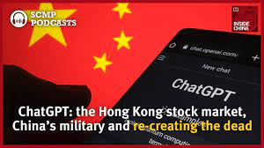
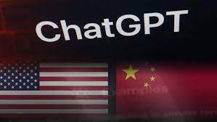
China: Significant steps in regulating AI and other emerging technologies

Slide 8
China and Digital Regulations
in August 2023 issued a document with the deadline of 2025 to boost the country’s global competitiveness in the digital economy.
With the output of 10 per cent of the country’s GDP,
To enhance its basic research capabilities in “strategic areas” such as sensors, quantum information, communications, integrated circuits, key software, big data, AI, blockchain and new materials.
increasing the size of the software and information technology service industry from 8.2 trillion RMB (US$1.3 billion) currently, to 14 trillion RMB by 2025, and boost digital trade from 37.2 trillion RMB to 46 trillion RMB over the same period.

Slide 9
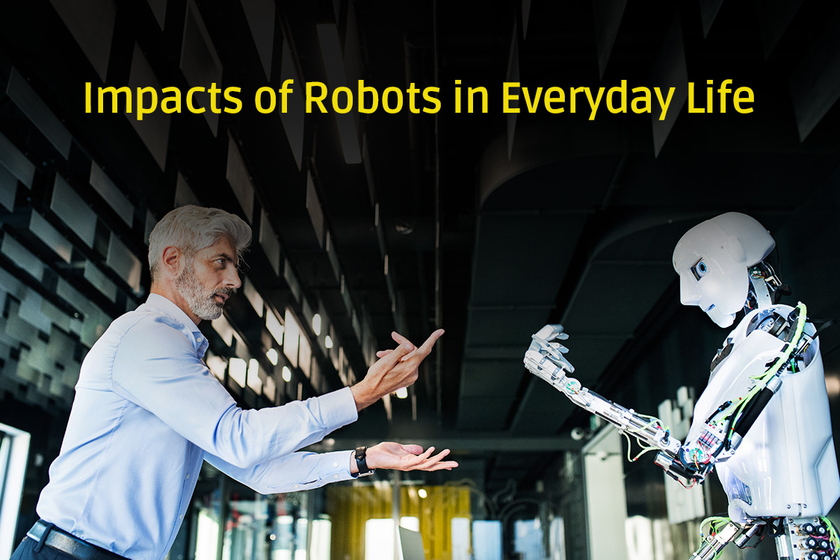
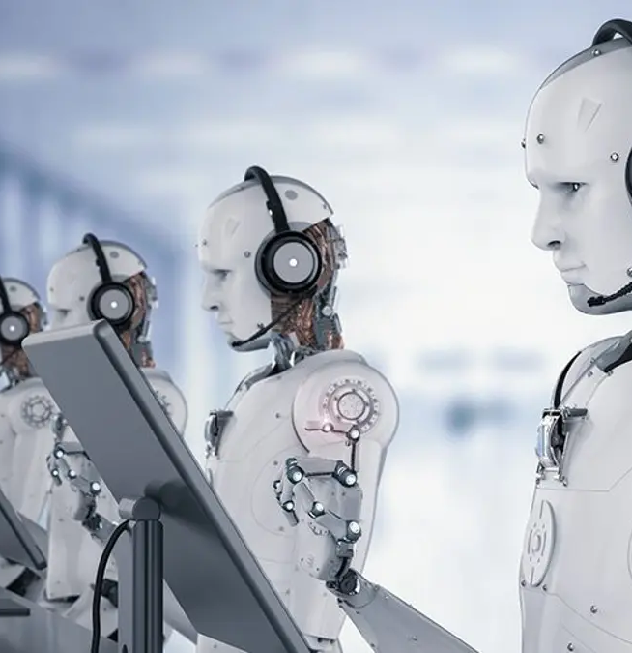
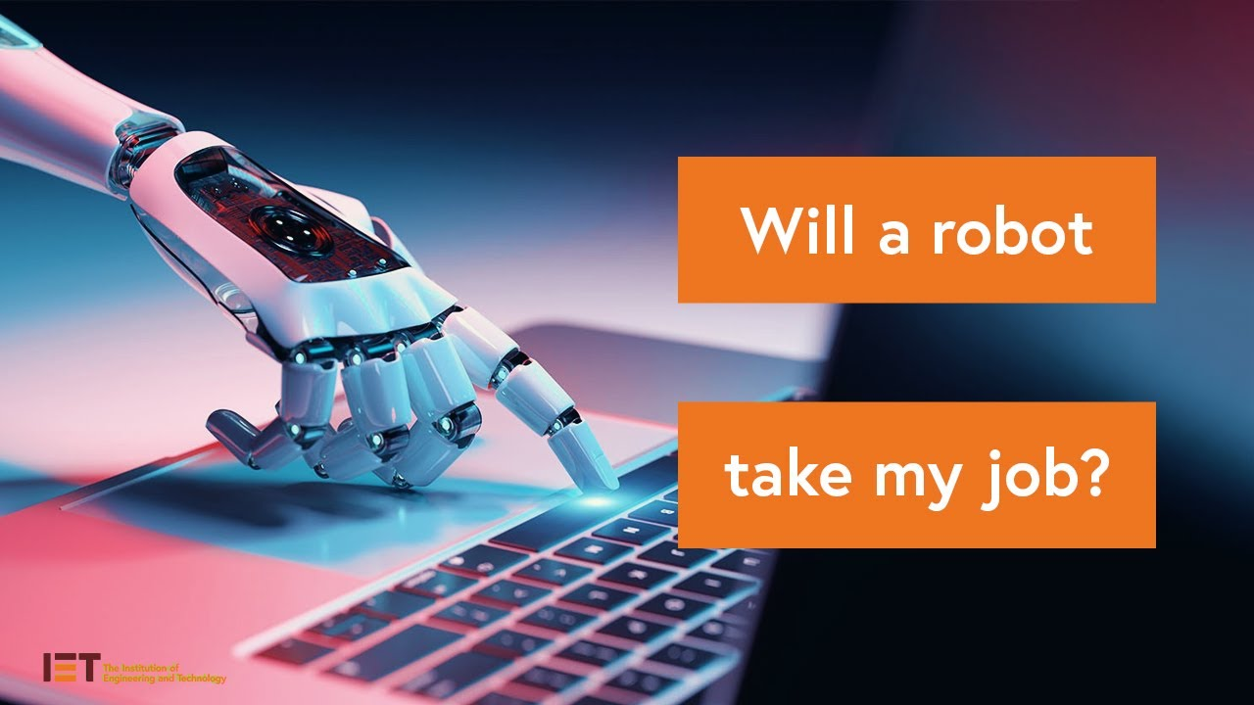
European Union: AI Act
decisions on job
loan applications
to control, or even ban, “high-risk” AI systems.
force companies to disclose their source of data for creating and training their models.

Slide 10
EU AI Act” is a piece of prescriptive product safety legislation

Slide 11
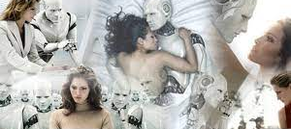
AI lifecycle management by EU
EU prohibits AI practices posing unacceptable risks
AI systems with low and minimal risks are not subject to any regulations
AI systems with high risk and limited risk fall in the middle

Slide 12
UK “horizontal” (or “cross-sectoral”) approach
adopting a principle- based and sectoral approach
Rather than regulating AI through legislation,

Slide 13
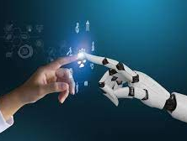
UK CONTINUES,..
WHITE PAPER with 5 principles:
Security,
Transparency,
Fairness,
Accountability
contestability

Slide 14
formulating of a legislation Bill on AI regulations.

Slide 15
G-7 Summit in Hiroshima

Slide 16
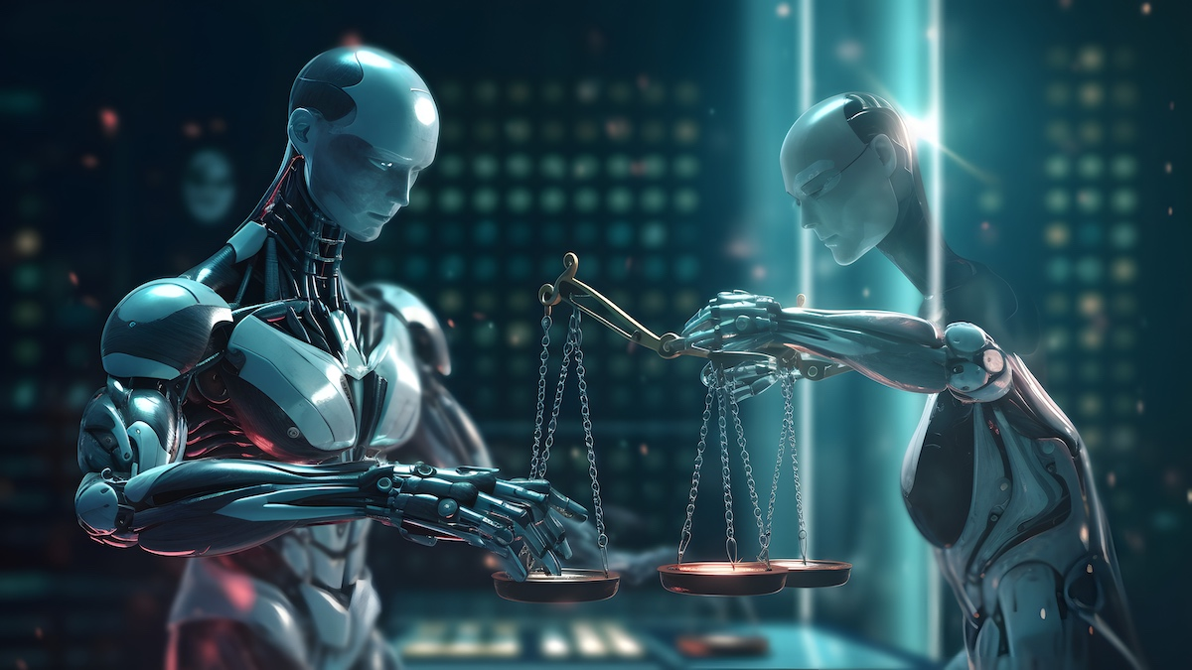
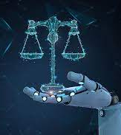
EU- AI regulation as a model?
it will apply in full only beginning in 2026,

Slide 17
Can we regulate them?
Navigating the Future: Overcoming the Challenges of Emerging Technologies

Slide 18
AI will change human life but, designed well, an AI governance regime of the kind could suit all

Slide 19
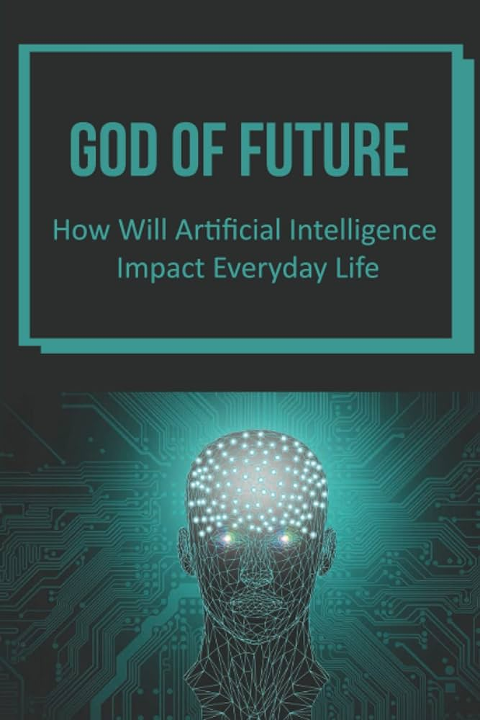
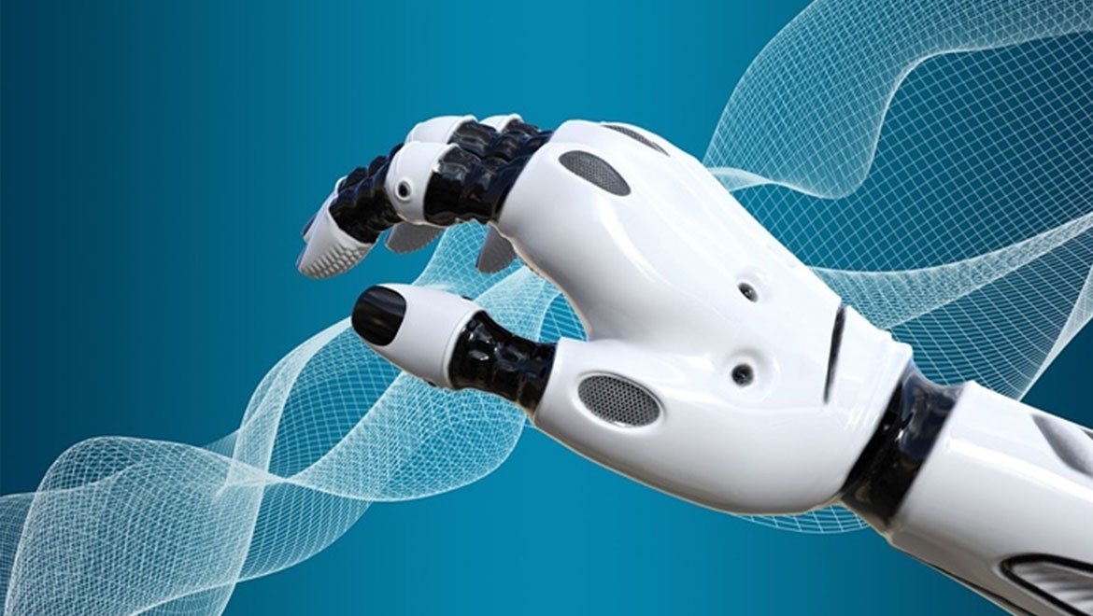
PROMOTE THE BEST, PREVENT THE WORST
enshrining principles and structures that promote the best in AI while preventing the worst.

Slide 20
2023 tope emerging technologies
Blockchain and Defi
Artificial iNtelegence
Virtual reality
Cyber Security
5 G Network
Internet of Things
Machine Learning
FinTech
Cloud Computing
Voice Assistance
Green Technology

Slide 21
FUTURE !!!
To address the challenges ahead, Industry self-regulation is an important first step.
at least three building blocks for the regulation of frontier models are needed:
(1) standard-setting processes to identify appropriate requirements for frontier AI developers,
(2) registration and reporting requirements to provide regulators with visibility into frontier AI development processes, and
(3) mechanisms to ensure compliance with safety standards for the development and deployment of frontier AI models.

Slide 22
THIS IS NOT THE END!
谢谢. xièxiè
THANK

